Slide 1
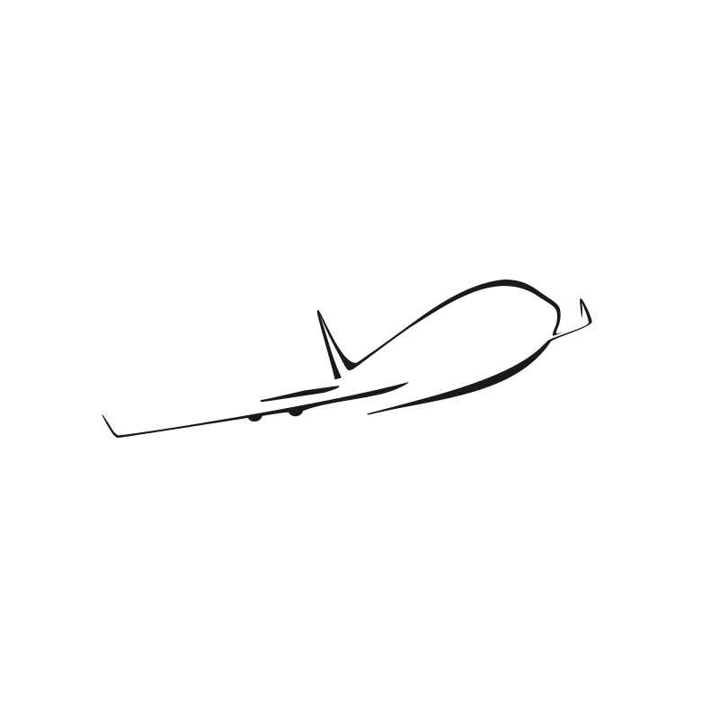
CSC380 – Airplane Application
Andrew Spano, Jimmy Nguyen, Zachary Gudlin

Slide 2
In addition, prepare a presentation that you'll use during the final exam slot of the class. Make a few slides that introduce the team and the project, describe your code base and relevant parts of the document. You will have about 12 minutes per group: spend about 5 minutes presenting your slides, then about 5 minutes more doing a demonstration of your project in front of the class. Make sure you are ready to answer questions in the remaining minutes.

Slide 3
Team Members Andrew Spano Jimmy Nguyen Zachary Gudlin

